Slide 1

Day 4- Agenda
Building With Maven.
Junit Test Cases.

Slide 2
Building With Maven
Agenda
Overview of Maven.
Maven POM.XML File.
Environment Setup.
Creating a java project using maven.
Maven Directory Structure.
Executing the mvn command.

Slide 3
Overview of Maven :
What is Maven? : Maven is a powerful project management tool based on the Project Object Model (POM). It simplifies the build process, manages dependencies, and provides consistent project structures.
Maven is written in Java and can be used to create projects written in Java, C#, Scala, and Ruby.
Why Use Maven?: Maven resolves common development challenges, such as managing JAR dependencies, creating project structures, and automating builds.
Key Concepts :
POM.xml (Project Object Model): The central configuration file for Maven projects.
Dependency Management: How Maven handles project dependencies.
Build Lifecycle: Maven defines a set of phases (e.g., compile, test, package) for building projects.
Plugins: Extend Maven’s functionality through plugins.
Repositories: Understand local, central, and remote repositories.

Slide 4
POM.XML
POM Stands For → Project Object Model.
POM.XML is the central configuration file for Maven projects which is the heart of Maven projects.
Project Management:
Define project coordinates (group ID, artifact ID, version, name, Description).
Specify project dependencies.
Plugins (Plugins contains configurations, Depending on these configurations project/ build will run)
Build Settings:
Set source and target Java versions.
Define project packaging (JAR, WAR, etc.)

Slide 5
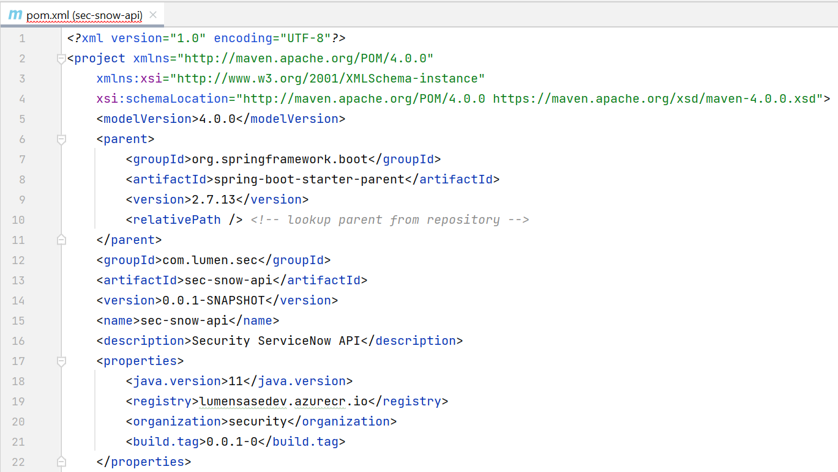
Sample POM.xml:

Slide 6
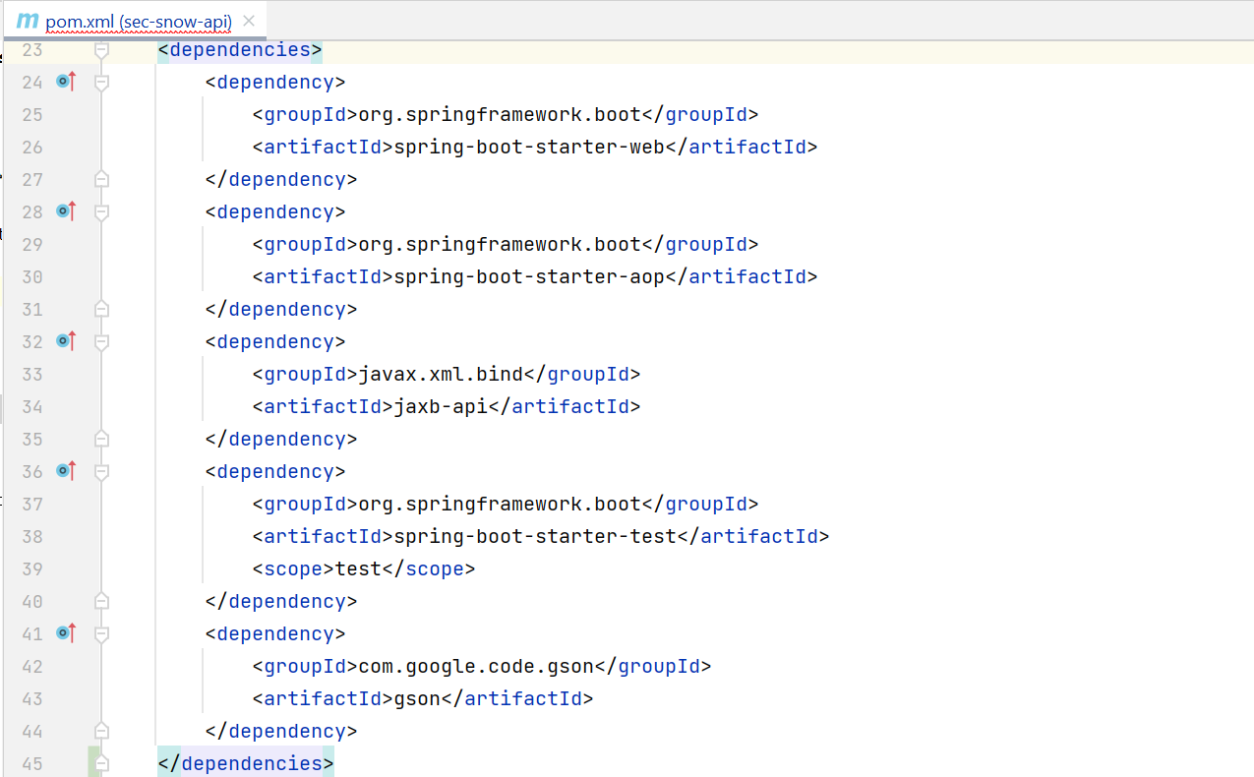
Sample POM.XML

Slide 7
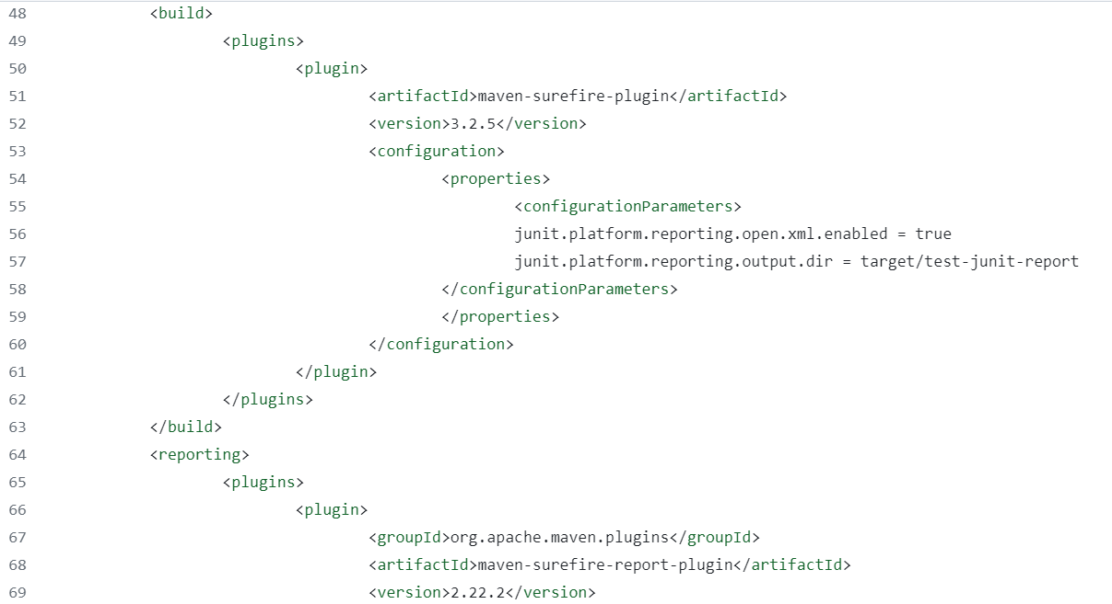
Sample POM.XML

Slide 8
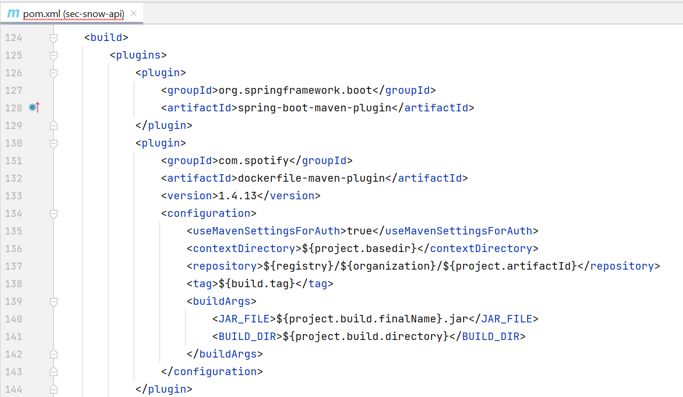
Sample POM.xml

Slide 9
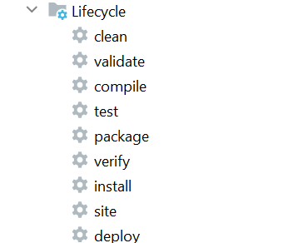
Maven Build Life Cycle:

Slide 10
Environment setup:
Install Maven: Download and install Maven on your system.
Configure Environment Variables: Set up M2_HOME and add Maven’s bin directory to your system’s PATH.

Slide 11
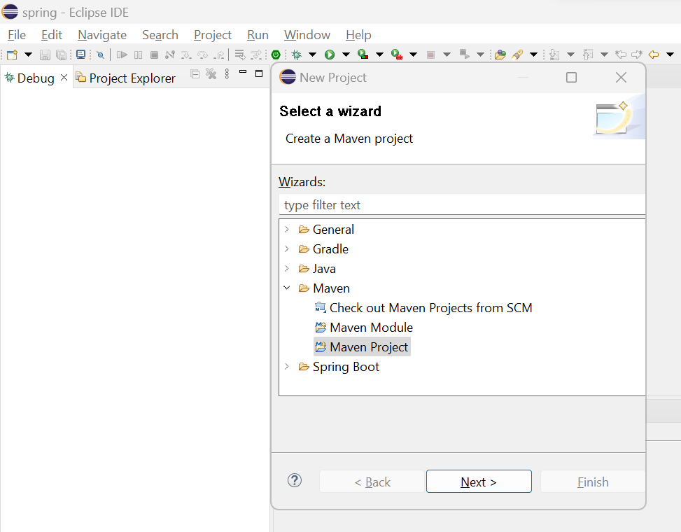
Creating a java project using maven:

Slide 12
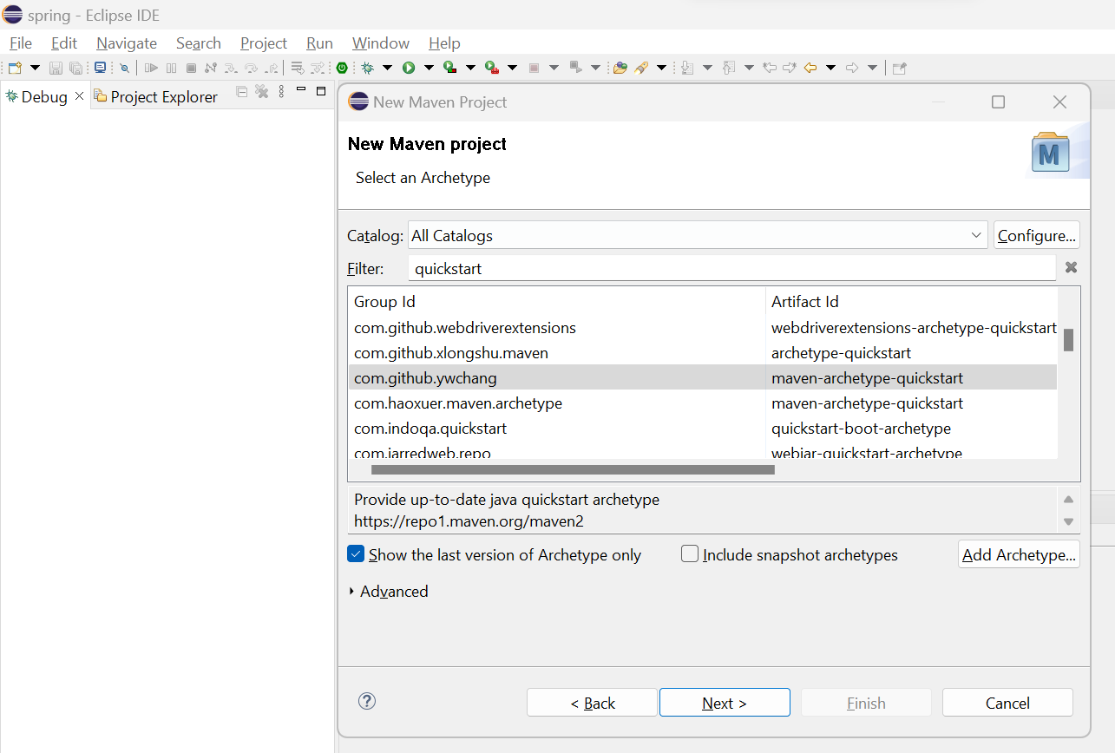
Creating a java project using maven:

Slide 13
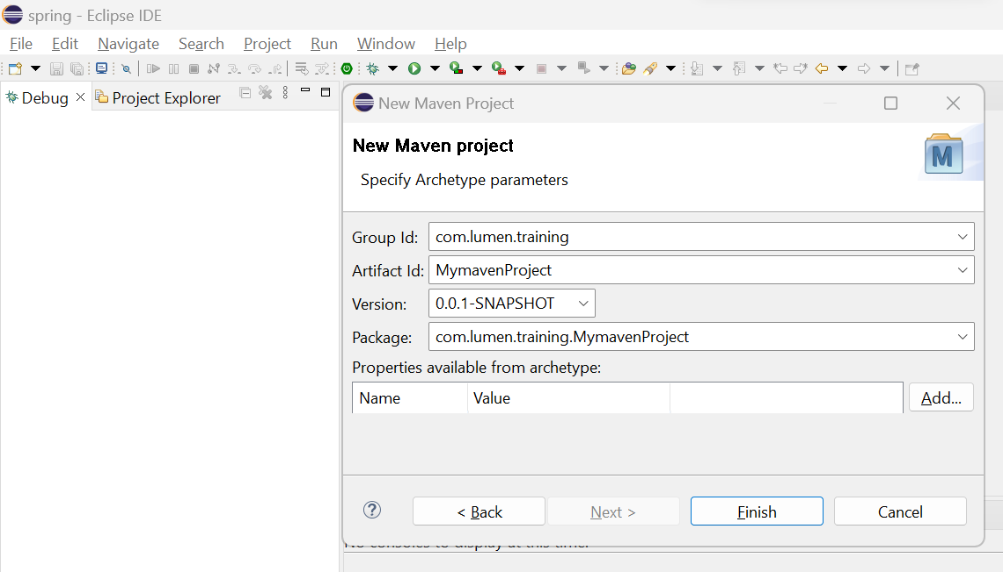
Creating a java project using maven:

Slide 14
Maven Directory Structure:
└───maven-project
├───pom.xml
├───README.txt
├───NOTICE.txt
├───LICENSE.txt
├───target
└───src
├───main
│ ├───java
│ ├───resources
│ ├───filters
│ └───webapp
├───test
│ ├───java
│ ├───resources
│ └───filters
├───it
├───site
└───assembly

Slide 15
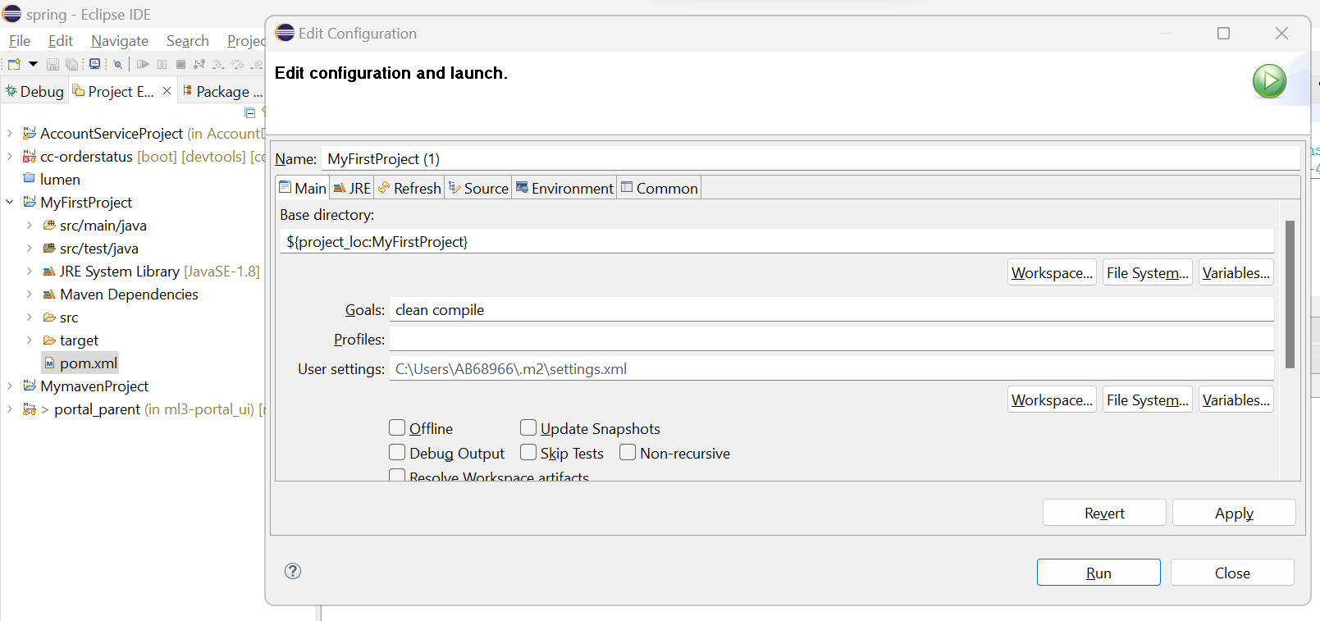
Executing the mvn command:

Slide 16
Maven Dependencies Version upgrade/Downgrade:
Play with versions of dependencies by updating/downgrading and look at the .jar files in project explorer.
How to collect dependency from central Maven repository and add to the POM.xml

Slide 17
Introduction to JUnit5.0
•What is JUnit?
•Junit5 -> Junit Jupiter + Junit Vintage + Junit Platform
•Importance of testing in software development
Benefits of Junit
•Ensures code quality: Detect bugs early in the development process.
•Automates testing: Saves time and effort by automating repetitive testing tasks.
•Supports Test-Driven Development (TDD): Write tests before writing code.
•Integrates with build tools: Compatible with Ant, Maven, and Gradle.

Slide 18
Junit setup
<dependencyManagement>
<dependencies>
<dependency>
<groupId>org.junit</groupId>
<artifactId>junit-bom</artifactId>
<version>5.10.2</version>
<type>pom</type>
<scope>import</scope>
</dependency>
</dependencies>
</dependencyManagement>
<dependencies>
<dependency>
<groupId>org.junit.jupiter</groupId>
<artifactId>junit-jupiter</artifactId>
<scope>test</scope>
</dependency>
</dependencies>

Slide 19
Common Asserts
Junit annotations
•@Test – tells that a method is a test method
•@DisplayName – used to customize the display names on test runners and reports
•@ParameterizedTest – used to run a test multiple times with different arguments
•@RepeatedTest – used to repeat a test a specified number of times
•@BeforeEach – used to run something before a test method
•@AfterEach – used to run something after a test method
•@BeforeAll – used to run something before all tests
•@AfterAll – used to run something after all tests
•@Disabled – used to disable test cases
•@Tag – used to declare tags for filtering tests
assertEquals(): - Asserts that two values are equal.
assertNotEquals(): - Asserts that two values are not equal.
assertTrue(): - Asserts that a condition is true.
assertFalse(): - Asserts that a condition is false.
assertNull(): - Asserts that a value is null
assertNotNull(): - Asserts that a value is not null.

Slide 20
Example
https://github.com/BobdiyaNayak/Junit

Slide 21
Handling exceptions in Junit
AssertThrows
Creating test suites
A test suite is used to bundle and run test cases together
•@Suite – denotes that the class is a test suite
•@SelectClasses - specifies the names of classes to select when running a test suite
•@SelectPackages - specifies the names of packages to select when running a test suite
•@IncludePackages – used to include subpackages
•@ExcludePackages – used to exclude subpackages
•@IncludeClassNamePatterns – used to include all classes that match a pattern
•@ExcludeClassNamePatterns – used to exclude all classes that match a pattern
•@IncludeTags – used to include tests with specific tags
•@ExcludeTags – used to exclude tests with specific tags

Slide 22
Junit report
•XML Reports:
i. maven test
ii. maven test –Dtest="ClassName"
•HTML Reports:
i. maven surefire-report:report
<build>
<plugins>
<plugin>
<artifactId>maven-surefire-plugin</artifactId>
<version>3.2.5</version>
<configuration>
<properties>
<configurationParameters>
junit.platform.reporting.open.xml.enabled = true
junit.platform.reporting.output.dir = target/test-junit-report
</configurationParameters>
</properties>
</configuration>
</plugin>
</plugins>
</build>
<reporting>
<plugins>
<plugin>
<groupId>org.apache.maven.plugins</groupId>
<artifactId>maven-surefire-report-plugin</artifactId>
<version>2.22.2</version>
</plugin>
</plugins>
</reporting>

Slide 23
Resources
•https://lumen.percipio.com/courses/75f99acf-53fd-45f0-b2bc-4f52ea52c4d7
•https://lumen.percipio.com/courses/b06a5973-f759-4451-9963-7f0b675a5e43
•https://lumen.percipio.com/courses/12ae025e-d58d-48f7-9a37-193bd2efa119
•https://lumen.percipio.com/courses/3605f136-e073-42d9-82ec-e325b9289217
•https://lumen.percipio.com/courses/1a5ab71c-cb63-48b5-be1d-a6b45c350a64

